Slide 1







Sandro Liberatori
Certification of Agricultural Machines as an important tool for a globalised agriculture

Slide 2




ENAMA
Farmers Organization
Farm Contractors/
Custom Hire
Manufacturers
Dealers
Public Sector
CIA
Coldiretti Confagricoltura
UNIMA
FEDERUNACOMA
CONFARTIGIANATO
ASSOCAP
Ministry of Agriculture Regions
CRA
ACTIVITIES IN THE FIELD OF AGRICULTURAL ENGINEERING
AND NOTIFIED CERTIFICATION BODY

Slide 3






Machinery Certification:
ENAMA Certification of performances and
safety of agricultural machines
VS ENAMA Certification of safety of agricultural machines
ENAMA Certification of components of
agricultural machines
ENAMA/AEF Certification of ISOBUS Technologies
Agroenergy Certification
ENplus Pellet Certification
Agroforestry solid biofuel Certification
(together with CIB)
Biogas Plant Certification

Slide 4
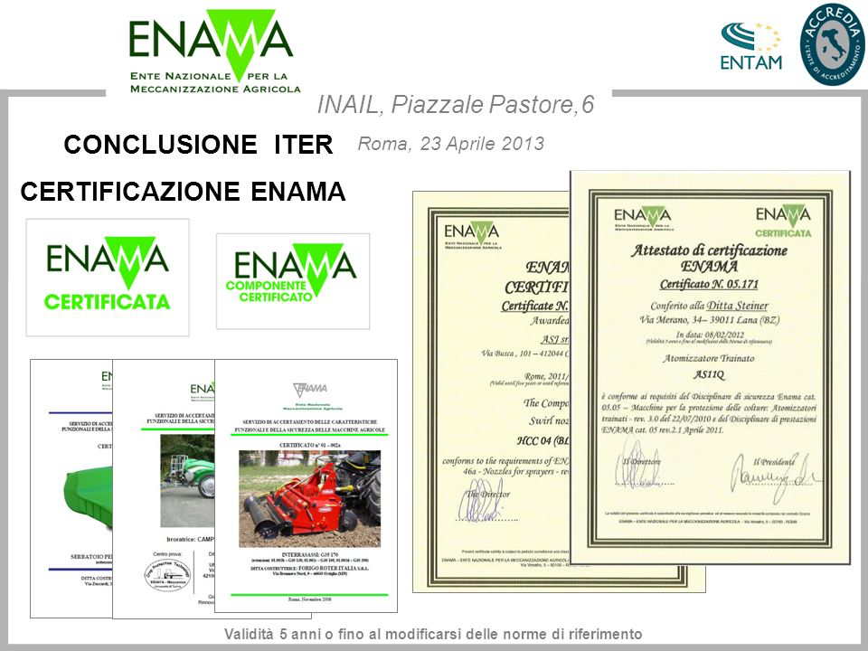
Certification as a tool for dealers
VALIDATION OF TECHNOLOGIES
ENAMA Certification
=
Best investment for Governments
Guarantee for farmers and dealers
Added value for manufacturers
BENEFITS FOR DEALERS

Slide 5


In a context of GROWING GLOBALISATION
COMMON RULES
In order to assure alla stakeholders a fair competition and trade
and TECHNICAL STANDARDISATION is an important tool

Slide 6
WTO (World Trade Organisation) deals with the global rules of trade between nations. Its main function is to ensure that trade flows as smoothly, predictably and freely as possible.

Slide 7
Global market
Global Harmonisation of Standardardisation, Testing and Certification
Trade will flow smoothly, predictably and freely as possible with common rules

Slide 8
What is Standardisation
as defined by ISO:
“document that provides requirements, specifications, guidelines or characteristics that can be used consistently to ensure that materials, processes and services are fit for their purpose”
and CEN adds:
“standards are created by bringing together all interested parties such as manufacturers, consumers and regulators of a particular material, product, process or service”

Slide 9
What is Standardisation
Example of the importance of standardisation and harmonisations:
ISO 9000 “de facto” the requirement for doing business in the world

Slide 10
What is Testing
A TEST IS A PROCEDURE FOR CRITICAL EVALUATION
Example of the importance of testing:
ISO 12003-2:2008 (Agricultural and forestry tractors – Roll over protective structures on narrow track wheeled tractors)

Slide 11
What is Testing
A standard may not include any information on the system in which the test should be performed
there may be many possibilities to perform the test that are open
and may offer different results

Slide 12
What is Certification
“The provision by an indipendent body of written assurance (a certificate) that the product, service or system in question meets specific requirements”

Slide 13
Harmonized standards facilitate cost effective and expedient conformity assesment for products, services…
however
In most situations the same standard may demand different conformity assessment activities

Slide 14
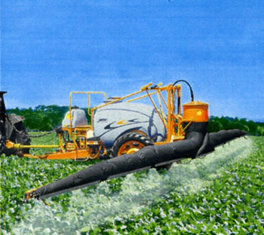
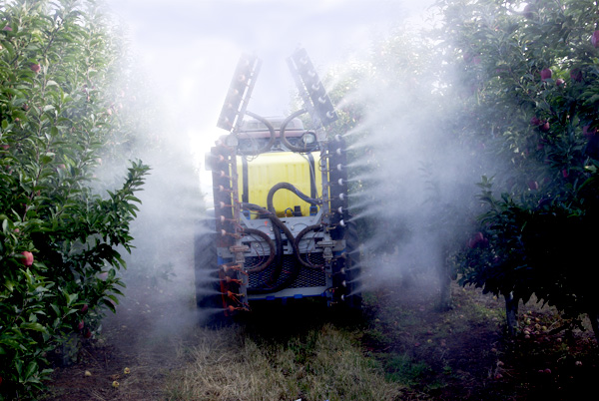
The best system: standardisation + testing + certification
Example: the ENTAM experience
Tests performed in EU testing stations basing on a common methodology
Different results: Standardisation + Testing = NOT SUFFICIENT

Slide 15



The best system: standardisation + testing + certification
Always consider thatthe best guarantee comes from a system considering:
STANDARDISATION + TESTING + CERTIFICATION
Good examples are:

Slide 16
Agriculture农业
3 Pillars of safety 安全性的三大支柱*
Human 人
Enviroment
环境
Food production
食品生产
Sustainable development
可持续发展

Slide 17
OECD and its Member Countries provide for Codes including common standardisation, testing and certification valid worldwide
ENTAM (European network Testing Agricultural Machines) provides for common testing activity valid in all Member coutries and being a guarantee for GVTs and stakeholders
ANTAM (Asian Network Testing Agricultural Machines)with 21 countries participating is the network active in thewidest agricultural area of the world providing for safer and more performing machines.

Slide 18
Areas of interest for Dealers
choice of components
advice on new technologies
finance
used machines - new markets
optimization of subsidies/investments
assurance of safety requirements
homologation
Dealer
training of experts
assurance for well performing machines/equipments
maintenance and spare parts

Slide 19
Areas of interest for Dealers: technical and financial
advice on new technologies
new sectors as Precision Farming, ISOBUS technologies need advice for farmers (certification)
choice of components
best components for machines e.g. mixer for sprayer
optimization of subsidies/investments
susbsidy policies need advice (certification)
used machines - new markets
used machines have to be up-dated and
can be sold in other world areas (certification)
other
finance
financial and insurance services

Slide 20
Areas of interest for Dealers: certification/homolgation
homologation
assurance of safety requirements
homologation is often necessary by regulations and subsidies.
e.g. Directives on the control and use of sprayers …
safety requirements for humans, environment and food production
(certification)
certification services
other
assurance for well performing machines/equipments

Slide 21
Areas of interest for Dealers
training of experts
training is fundamental for a good performing machines and new technologie (certification)
maintenance and spare parts
Other
after sale services

Slide 22
In conclusion in the coming years the scenario will change very quickly and new technologies as precision farming will change the approach to agriculture and new players will join.
We have a clear demonstration when we speak about precision farming that only a decade ago was a matter for some agricultural engineers and nowadays it’s a must for Microsoft, Google etc.
Agriculture is always the PRIMARY SECTOR and there is no life without it.
In this scenario there are and will be new opportunities for those who will take them.

Slide 23

THANK YOU FOR YOUR ATTENTION
sandro.liberatori@enama.it
www.enama.it

