Slide 1







Sandro Liberatori
Energy production plants as a new activity for farmers and dealers

Slide 2

ENAMA
Farmers Organization
Farm Contractors/
Custom Hire
Manufacturers
Dealers
Public Sector
CIA
Coldiretti Confagricoltura
UNIMA
FEDERUNACOMA
CONFARTIGIANATO
ASSOCAP
Ministry of Agriculture Regions
CRA
ACTIVITIES IN THE FIELD OF AGRICULTURAL ENGINEERING
AND NOTIFIED CERTIFICATION BODY

Slide 3






Machinery Certification:
ENAMA Certification of performances and
safety of agricultural machines
VS ENAMA Certification of safety of agricultural machines
ENAMA Certification of components of
agricultural machines
ENAMA/AEF Certification of ISOBUS Technologies
Agroenergy Certification
ENplus Pellet Certification
Agroforestry solid biofuel Certification
(together with CIB)
Biogas Plant Certification

Slide 4
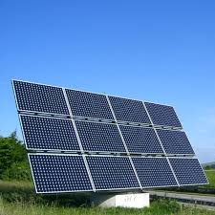
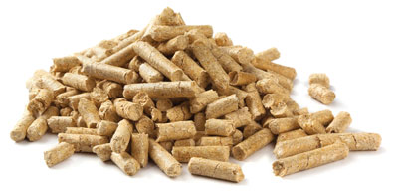
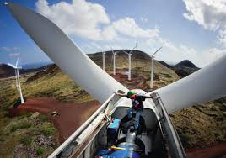
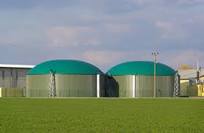
Certification as a tool for dealers
VALIDATION OF TECHNOLOGIES
ENAMA Certification
=
Best investment for Governments
Guarantee for farmers and dealers
Added value for manufacturers
BENEFITS FOR DEALERS

Slide 5

Agroenergy production lines
Pyrolysis
Heat
Annual crops, poliennal crops, short rotation forestry, fruit and vegetable pruning, twigs, etc.
Termochemical conversion
Gasification
Combustion
Electricity
Corn, oat grass,
sugar industry, agroindustrial wastes, sewage sludge, livestock effluent, manure, citrus pulp, fruit and vegetable processing industry wastes, etc.
Fermentation
Biofuels (Bioethanol)
Biological conversion
Biofuel (biomethane)
Digestion
Electricity
Heat
Electricity
Pressing
Physical – chemical conversion
Sunflower, rape, soy, oil palm, etc.
Heat
Esterification
Biofuel (biodiesel, oil)

Slide 6

Global Overview
Renewable energy is generally defined as energy that comes from resources which are naturally replenished on a human timescale such as sunlight, wind, rain, tides, waves, and geothermal heat. Renewable energy replaces conventional fuels in four distinct areas:
electricity generation
air and water heating/cooling
motor fuels
rural (off-grid) energy services
other.

Slide 7
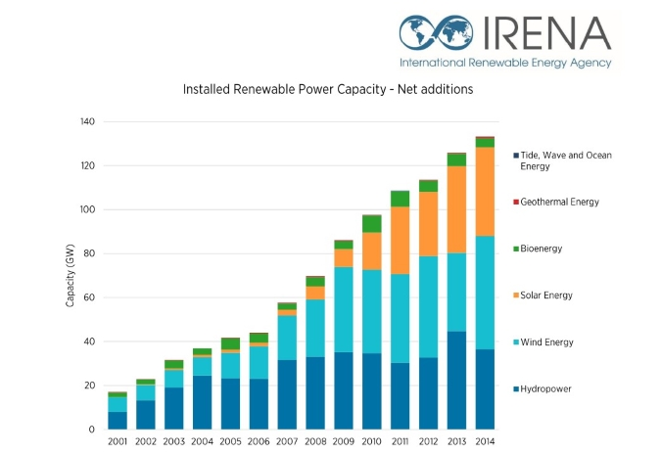
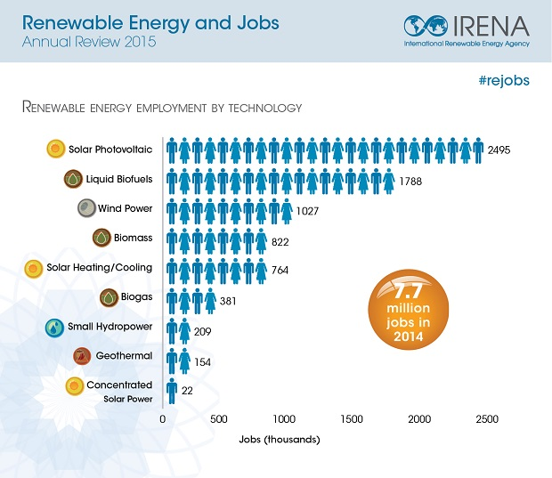
Global Overview

Slide 8
Overview in Europe
2020 RENEWABLE ENERGY TARGETS
The EU's Renewable energy directive sets a binding target of 20% final energy consumption from renewable sources by 2020. To achieve this, EU countries have committed to reaching their own national renewables targets ranging from 10% in Malta to 49% in Sweden. They are also each required to have at least 10% of their transport fuels come from renewable sources by 2020.
All EU countries have adopted national renewable energy action plans showing what actions they intend to take to meet their renewables targets. These plans include sectorial targets for electricity, heating and cooling, and transport; planned policy measures; the different mix of renewables technologies they expect to employ; and the planned use of cooperation mechanisms.
A NEW TARGET FOR 2030
Renewables will continue to play a key role in helping the EU meet its energy needs beyond 2020. EU countries have already agreed on a new renewable energy target of at least 27% of final energy consumption in the EU as a whole by 2030. This target is part of the EU's energy and climate goals for 2030.
Targets for 2030:
a 40% cut in greenhouse gas emissions compared to 1990 levels
at least a 27% share of renewable energy consumption
at least 27% energy savings compared with the business-as-usual scenario

Slide 9
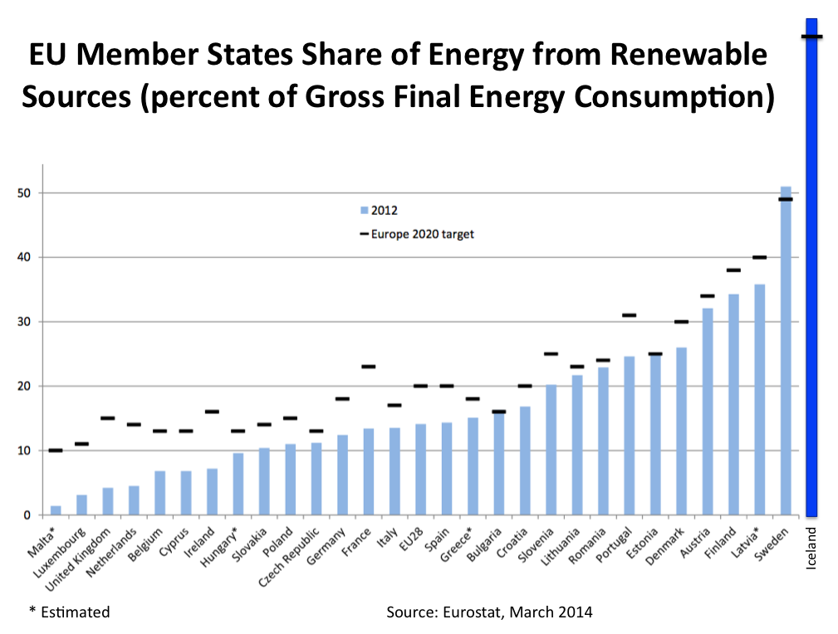
PROGRESS REPORTS
The latest report from 2015 states that 25 EU countries are expected to meet their 2013/2014 interim renewable energy targets. In 2014, the projected share of renewable energy in the gross final energy consumption is 15.3%.
According to data from Eurostat, the total share of renewable energy in the EU in 2012 was 14.1%, up from 8.7% in 2005.

Slide 10
Italy
Italy imports more than 83 % of its primary energy. In particular, the Italian agricultural sector imports 100 % of its primary energy needs. Today, an effort is being made towards a better mix of primary sources and towards reducing the country's dependence on imports, especially in this sector where there are considerable endogenous energy sources.
Total amount spent for the overall subsidies in the renewable energy sector is about 5,8 billion €.
Renewable energies play a leading role within the national energy system. They are used for the production of electricity (electric field) and for the production of heat (thermal field) as biofuels for transport sector.

Slide 11
Agroenergy sector
Solid biomass: forestry, agricultural and agro-industrial (such as wood chips, twigs, rice husks) products or by-products that can be used for heating or energy production of heat through combustion directly or through a gasification process.
Biogas/Biomethane: output from anaerobic digestion process and by the upgrading process. Linked to livestock, it was born with the aim of capturing the methane emissions from manure, using it for energy purposes. Later, it developed the co-digestion of other matrices, waste or specially grown, because of their interesting contribution to the production of biogas / biomethane and at the same time for heat production.
Bioliquids or biofuels: biofuels are used in a mixture with fossil fuels, but are closely related to agriculture, because the raw materials are of vegetable origin.

Slide 12
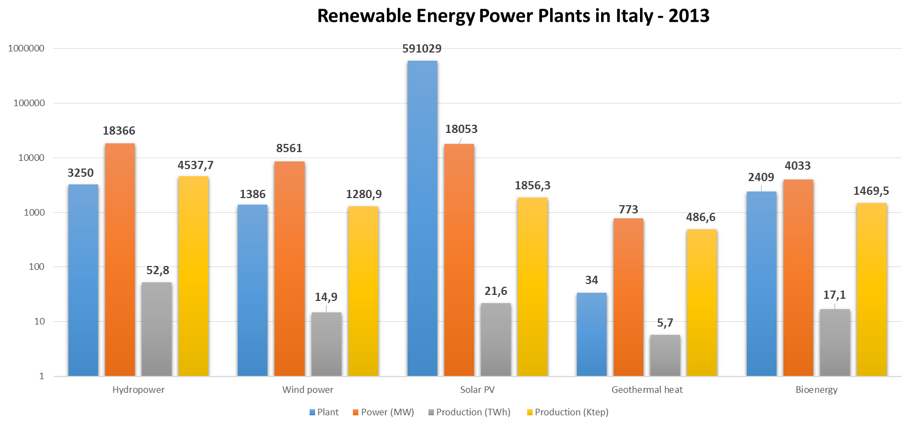
Italy
Agro energy | Plants | Electric Power (MW)
2010 | 2352 | 669
2011 | 2825 | 1213
2012 | 3802 | 2199
2013 | 4033 | 2409

Slide 13
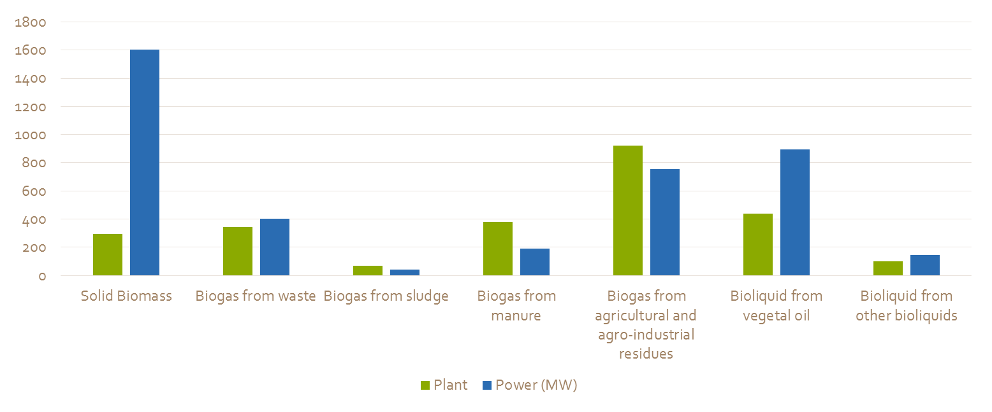
Italy

Slide 14
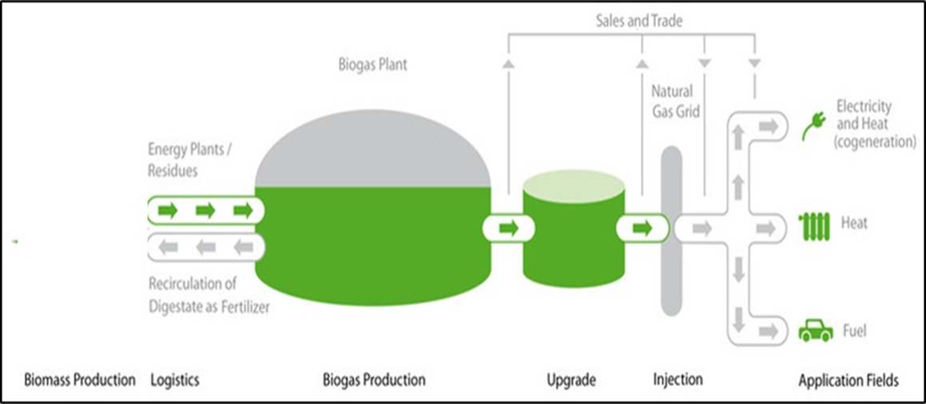
DIGESTATE
Fertilizers
Bioplastics
etc.

Slide 15
Areas of interest for Dealers
choice of components
advice on new technologies
finance
optimization of subsidies/investments
assurance of safety requirements
homologation
Dealer
training of experts
assurance for well performing machines/equipments
maintenance and spare parts

Slide 16
Areas of interest for Dealers: technical and financial
advice on new technologies
plants are often a mix of different technologies that have to be combined together (certification)
choice of components
choice based on the most up to date technologies
optimization of subsidies/investments
renewable energy is often closely linked to subsidy policy and farmers need advice (certification)
finance
other
financial and insurance services

Slide 17
Areas of interest for Dealers: certification/homolgation
homologation
assurance of safety requirements
homologation is often necessary by regulations and subsidies
safety requirements for humans, environment and food production
(certification)
certification services
other
assurance for well performing machines/equipments

Slide 18
Areas of interest for Dealers
training of experts
training is fundamental for a good performing plant (certification)
maintenance and spare parts
Other
after sale services

Slide 19
The Dealer can offer customers much more than agricultural machines and spare parts
The new sectors of activity in agriculture offer new and interesting opportunities.
The Dealer should also offer advice, training, technical and financial support.
Certificatin is a guarantee for Dealers that standards have been fullfilled and that activity is performed at its best
Dealers will have more opportunities offering a full line of services

Slide 20

THANK YOU FOR YOUR ATTENTION
sandro.liberatori@enama.it
www.enama.it

